Slide 1

LatentView Proposal – Data Migration Capabilities
Aug 2018

Slide 2
Agenda
1
About LatentView
2
Data Migration Capabilities
3
Case Studies
4
Effort Estimation

Slide 3
About LatentView

Slide 4


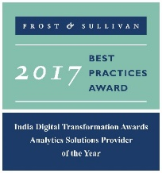




LatentView – A World Class Analytics Company
Awards & Recognition
Founded in
Over
Grown
Work with
Strong Performer - Customer Analytics Services, 2017
600
11
30+
2006
People strong
times in last
six years
Fortune 500
firms
Repeat business at
Member of
2009-2017
Technology council
Rated as Top
10
5%
4/5
>85%
Repeat
business
Analytics companies to work for in India
Re-investment in Research and Development
Top technology companies engage with us

Slide 5
Cutting Edge Solutions in Advanced Analytics
Hindsight – What happened?
Insight – Why did it happen?
Foresight – What should we do?
Data Acquisition
Acquiring the data from both traditional, big data and other digital sources.
Data Processing
Data preparation for analysis and insights, using internal, external, batch, streaming, structured, unstructured data. (On-premise and cloud based techs)
Reporting & Visualization
Creating dashboards and reports for a business-focused audience
Graph Analysis
Better exploration of frequency, strength and direction of relationships
Exploratory Analysis
Experience in gaining deep insights from unstructured and structured data traditional methods
Natural Language Processing
Extract entities, tag PoS, extract relationships, analyze sentiments
Real Time Analytics
Better exploration of frequency, strength and direction of relationships
Deep Learning
Experience in analysing connection data for clustering/ causality
Machine Learning
Deep experience with various machine learning algorithms, including Ensemble Learning, Neural Networks, etc.

Slide 6
Data Migration Capabilities

Slide 7










Data Migration Capabilities & Process Flow
Our Capabilities
Unifying and Blending data sets
Enhanced Data Processing capabilities
Building Dashboard Capabilities
Data Modeling
Capabilities
Consolidating data from multiple siloed data sources
Proven expertise in processing Structured, Unstructured and Multimedia data
Creating a Data Lake for efficient data retrieval functionalities
Building a one stop dashboard to track & measure the marketing spends & impact using defined KPI metrics
Our Approach
Business
Understanding
Data
Understanding
Wireframe
Designing
Business
Review
Data
Consolidation
Reports/
Dashboards
Iterative process

Slide 8

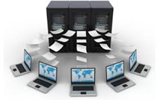






Approach Note
DATA SOURCES & REPORTS
PRIORITIZATION
REPLICATE / MIGRATE
CROSS VALIDATE
AUTOMATE / SCHEDULE
Prioritization of reports based on :
No of users
Recurrence / On Demand
Data Availability
Replicate / Migrate the data sources to the Data Lake
Cross validation of the replication/ migration
Automation / Scheduling of the entire process
Excel Reports :
ODBC connection can be primarily used for data connection (less than a day effort for a single connection)
Will be shared as attachments via email or share drive
Manual refresh has to be performed in case of periodic reports
Tableau Reports :
Data source can be connected via multiple options. Most preferred is connecting to the data lake directly via Teradata / MySQL / MS SQL connectors
Tableau reports will be published in the server and the link can be shared (User access can be role based)
Automated refresh can be performed via scheduling

Slide 9
Case Studies

Slide 10
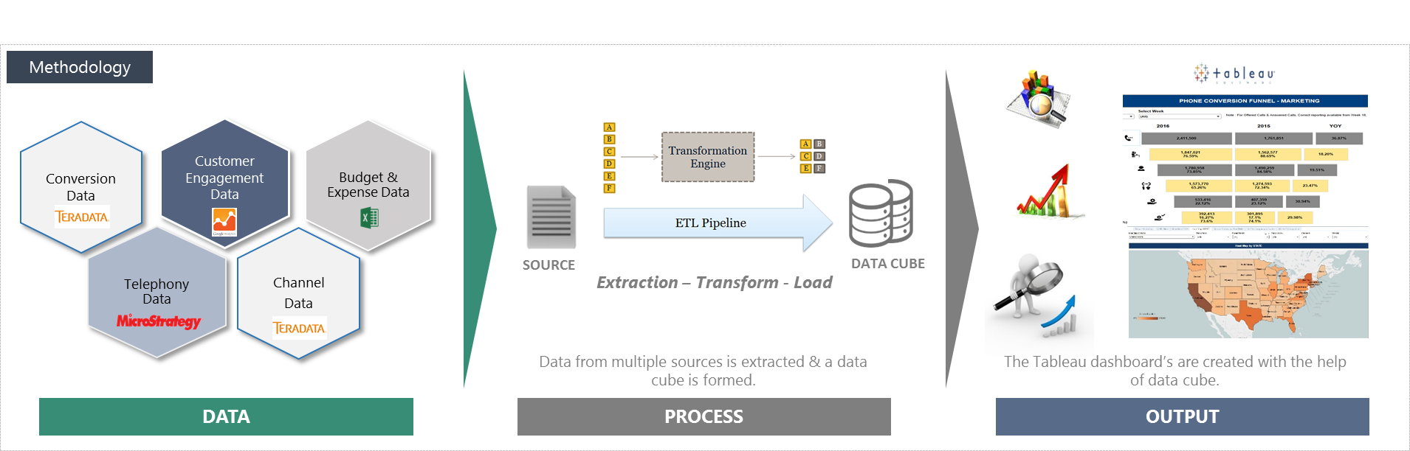
One Stop Conversion Funnel Dashboard from Multiple Sources
Leading Home Appliance Repair Service Provider in US
The “Before” State
Clients were in needs of a visualization solution for the Marketing & Non Marketing channels
To enable descriptive analytics and provide Visualization solution for Marketing team and to help in Strategic decision making
LatentView Solution
Created a data lake by extracting data from multiple data sources and developed tableau dashboard’s & reports tracking the conversion funnel
The dashboard provides Marketing KPI's at a channel level across geographies on a weekly basis comparing YoY performance.
The “After” State
The Conversion funnel helped in understanding the flow of business and identified bottlenecks & areas of concern
The Marketing team understands the business trends and seasonality of various Channels across geographies

Slide 11
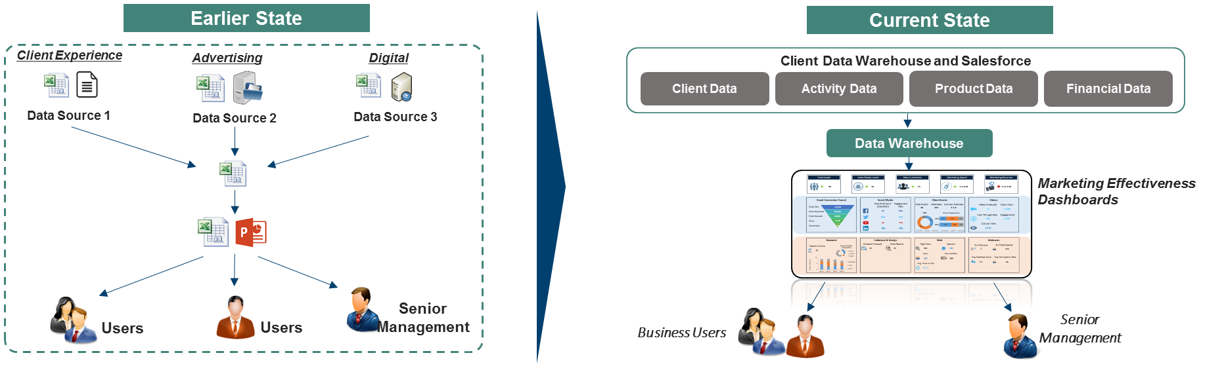
Building Aggregated Views of Marketing KPIs
Leading Asset Management Company in UK
The “Before” State
Lack of a holistic view on measuring overall marketing performance across all channels, asset classes and campaigns led to consuming repetitive efforts on building aggregated Marketing KPIs
LatentView Solution
Streamlined process of delivering an MI at aggregate and granular level across channel, asset class, campaign.
Key marketing KPI’s delivered covering output, reach, engagement and effectiveness
The “After” State
The Marketing Effectiveness Dashboards used by Senior Management & Business users helped in measuring campaign performance and actual vs. forecast metrics comparison

Slide 12
Effort Estimation

Slide 13








Effort Estimation & Governance Structure
Resources
2 Offshore Resources
Time Period
4 Months
Pricing
USD 40,000
Note
Agile methodology is to be adopted for this engagement
Additional resources & time duration will be accounted based on the quantity of reports involved
Client
LATENTVIEW ONSHORE TEAM
LATENTVIEW OFFSHORE TEAM
CLIENT PROGRAM
MANAGER
ENGAGEMENT MANAGER
PROJECT MANAGER
CLIENT TEAM
TEAM LEADS
DATA
ANALYSTS
TABLEAU
EXPERTS

Slide 14
Thank You
amritsagar.mohapatra@latentview.com

